Slide 1
Session 3
Data management and strategy, Basic statistics in R,

Slide 2
Exploratory Data Analysis - warnings
EDA = Question -> Visualise -> New Question
Not always that simple in epidemiology
Correlation != Causation
When constructing a model be careful not to be blinded by the data, always keep in mind whether you’re forming a prediction model or a causal model.
Relevant variables are not always the ones most strongly associated with exposure and outcome.
Be very careful about how your model makes certain assumptions about relationships between different variables

Slide 3
Good Data Management Practice
Again: always use a script and a master copy of data, stored in multiple places and backed up regularly
Think carefully about your WD and how that can be used by someone on a different computer
Communication of results is important;
Only plot your key points, and make them easy to understand
Keep variable names out of formal presentations and relabel them in ggplot2 to be more understandable to your audience

Slide 4
Words I will be using a lot
Exposure and Outcome of interest
Catch all terms for risk factors (exposures) and disease cases (outcomes)
Populations
Not necessarily (but can be) the entire population of an area or country, but normally only those exposed and at risk
Standard Deviation
How much values in a group differ from the mean of the values in a group
Standard Error
How far the sample mean is likely to be from the true population mean
Normal
Description of the bell curve distribution of where every value in the population is likely to be, and how likely it is to be in that position.

Slide 5
Measures of Binary Outcomes
Epidemiology involves mostly estimating the frequency and distribution of diseases in populations, and comparing the effect of exposures on the frequency of disease.
Frequency involves 3 important things to be defined
CASES (consider definition of case a prioiri, how to deal with repeat episodes)
POPULATION SIZE (DENOMENTATOR – pop at risk at the same time cases measured)
TIME (usually defined as person-time at risk)

Slide 6
Definitions
Prevalence = proportion of people in a defined population which has the outcome of interest at a specific point in time
Incidence = measure of the frequency of new cases
RISKS – probability of the occurrence of an outcome of interest – this is a PROPORTION
RATES – relationship between the number of new cases to the person time at risk

Slide 7
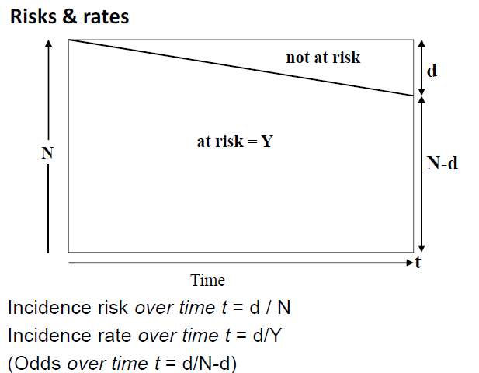

Slide 8
Quick Practical
Calculators + R
What was the prevalence of hospitalised COVID cases in Hospital X’s catchment area on May 27th?
Given that the population of the hospital catchment was 20,000 at the start of March, what was the risk of being hospitalised with COVID
Then what is the rate?

Slide 9
Measures of Effect
Boils down to being the ratios and differences to measure the association between exposures and outcomes
Ratios measure the magnitude of the effect of a risk factor on incidence of disease – i.e. the strength of association
Important to select the appropriate measurement
Vaccine efficacy is different to other measures of effect

Slide 10
Rate ratios, risk ratios, odds ratios
All are measurements of the strength of association
These have different properties and will come from different study types, but for rare outcomes will be quite similar
Values less than one will indicate the exposure of interest is a protective factor

Slide 11



BE CAREFUL
A study of papers published in two journals reported that 26% of the articles that used an odds ratio interpreted it as a risk ratio.
Odds Ratio
Risk Ratio

Slide 12
BE CAREFUL
Risk differences and ratios are intuitive to understand because we can imagine ourselves in that group of exposed and our probability of getting a disease being the risk, and the strength of that compared to the unexposed group is the RR.
For a rare outcome the RR is approximately equal to the OR
Odds ratios are more useful in most studies.
The odds ratio for the occurrence is the reciprocal of the odds ratio for non occurrence
The odds ratio for exposure (OddsD in e/OddsD in u_e) equals the odds ratio for the disease (odds of having exposure in diseased pop / odds having exp in healthy population) – THIS IS CRITICALLY IMPORTANT FOR CASE CONTROL STUDIES
Risk ratios are constrained by the risk in the unexposed group e.g. if risk in unexposed = 0.33 then the max RR = 3 (max OR = infinity)

Slide 13
Summary, why odds ratios?
When the outcome is rare, the odds ratio is the same as the risk ratio. This is because the odds of occurrence of a rare outcome are numerically equivalent to its risk. Analyses based on odds ratios therefore give the same results as analyses based on risk ratios.
When the outcome is common, risk ratios are constrained but odds ratios are not. Analyses based on risk ratios, particularly those examining the effects of more than one exposure variable, can cause computational problems and are difficult to interpret. In contrast, these problems do not occur in analyses based on odds ratios.
For odds ratios, the conclusions are identical whether we consider our outcome as the occurrence of an event, or the absence of the event.

Slide 14
Brief Practical
Extract a dataset with all COVID patients
Assume the exposure is being male and the baseline is female
What is the risk ratio, odds ratio?
Constructing a 2x2 table on paper will help with this

Slide 15
Difference between Effect and Impact
Ratio measures provide a measure of statistical association between a risk factor and disease
This tells us NOTHING about how much of the circulating disease in the population was caused directly by said risk factor
The IMPACT of a risk factor depends on how common it is in the population of interest and how strong the association is
Measures of effect do not take into account the rate in the total population when comparing groups, and are independent of the frequency of exposure in the population

Slide 16
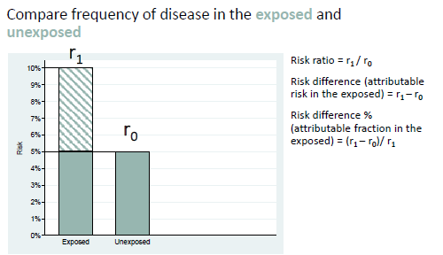
This is measuring effect of an exposure

Slide 17
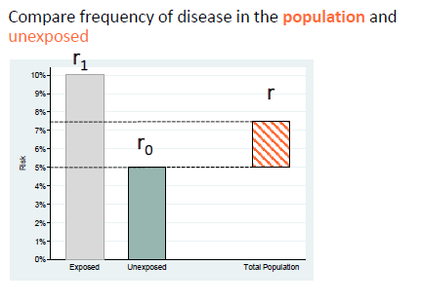
This is measuring the impact of an exposure

Slide 18
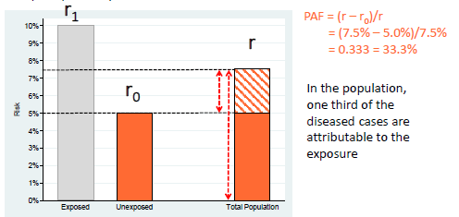
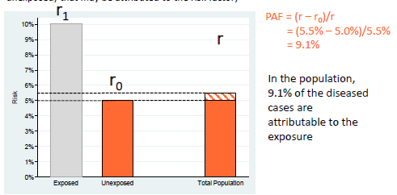
Population attributable risk and risk fraction
PAR = the absolute difference between the risk and rate in the whole population (r) and the risk or rate in the unexposed group
PAF = proportion of all cases in the whole population that may be attributed to the risk factor

Slide 19
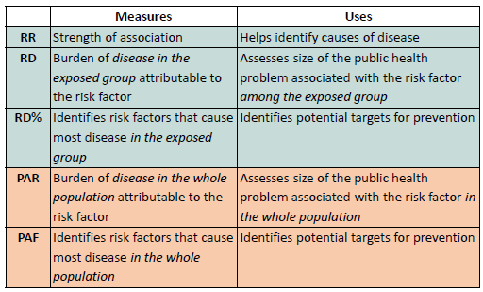

Slide 20
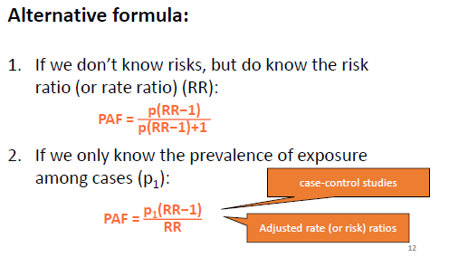
For reference

Slide 21
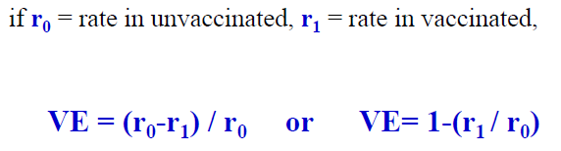

Quick note about vaccines
Percentage reduction in INCIDENCE among vaccinated which is ATTRIBUTABLE to vaccination

Slide 22
KEY POINTS
Measures of effect are measurements of statistical ASSOCIATION and compare exposed and unexposed
This association may or may not be CAUSAL, and more evidence is needed to determine causality (i.e. Bradford Hill Criteria, covered later)
Measures of impact compare the population and unexposed
Based on strength of association and how common the exposure is in the population
PAR is the absolute difference in risk b/w the population and unexposed
PAF is the proportion of all cases in the whole population that may be attributed to the exposure
ASSUMES all association is causal, exposure and frequency are measured accurately, removal of exposure removes the risk, the exposure itself is actually removable, all other risk factors remain constant

Slide 23
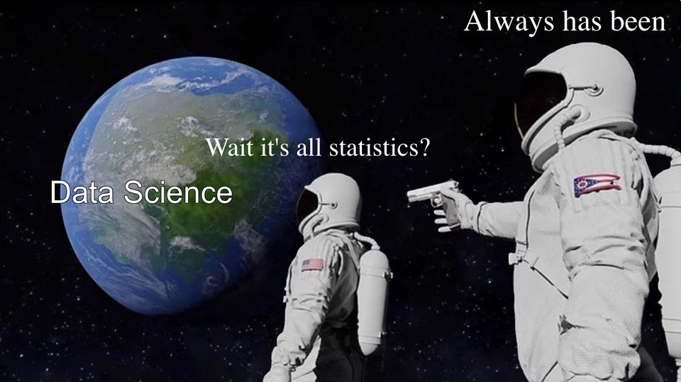
Enough yet?

Slide 24
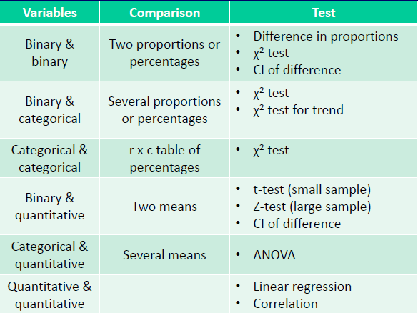
Quick summary of tests

Slide 25


Slide 26
Practical (if you wish)
For everyone who went to hospital from Jan onwards, were men significantly more likely to be admitted with COVID than women?
Steps
Create a new dummy variable of COVID 1 or 0
Extract that var and gender
Tabulate
Use chisq.test

